Slide 1
Computer networks
TYPES OF NETWORKS
NETWORK CONFIGURATIONS /TOPOLOGIES
TRANSMISSION MEDIA
By B. Vialva

Slide 2
TYPES OF NETWORKS
Networks can be classified according to the geographical area they occupy.
LAN – Local Area Network
WAN – Wide Area Network

Slide 3
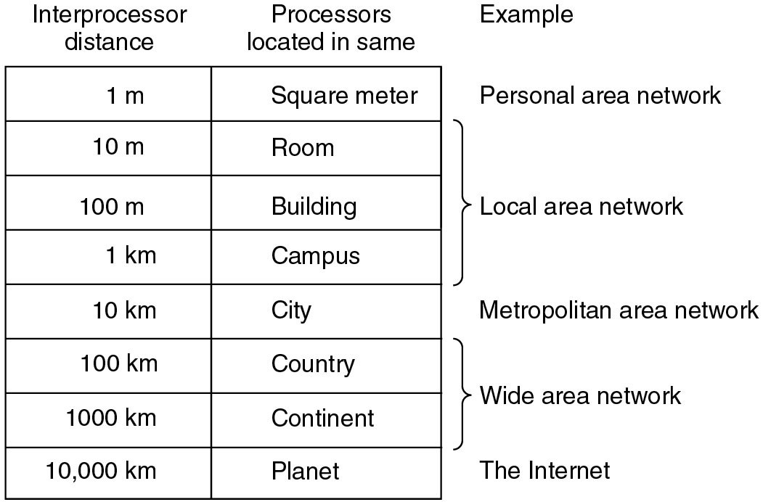
Classification of interconnected processors by scale.

Slide 4
Main features of LANs are:
Confined to a single building or site – the hardware and communications equipment is contained in one building or site.
Ownership of the communications equipment – the organization actually owns all the communications equipment (such as wiring, etc.) that links the terminals.

Slide 5
Main features of WANs are:
Hardware is spread over a wide geographical area – devices (computers, point of sale terminals, storage, etc.). The devices spread over multiple buildings and sites.
Third party telecommunications equipment is used – hardware in a WAN is situated in many sites, which can be in different countries. Telephone radio and satellite communications are needed, which are supplied by a third party. The organization with the WAN has to rent these services from a telecommunications supplier.

Slide 6
Internet
Internet – a huge group of networks joined together. Each of these networks consists of lots of smaller networks.

Slide 7
Difference between the www and the internet
The internet and the WWW is not the same thing.
World Wide Web – is a means of accessing information contained on the internet. It is an information sharing model that is built on top of the internet.
The www uses HTTP(hypertext transfer protocol), which is one of the languages used over the internet to transmit information.
The www makes use of browser software used to access documents called web pages.

Slide 8
PROTOCOLS
Different types of protocols:
IP – Internet Protocol
TCP – Transmission Control Protocol
FTP – File Transfer Protocol
HTTP – Hypertext Transfer Protocol

Slide 9
Network configurations
Networks can be arranged in various ways depending on the number of computers and how they are going to be used.
The way the network is arranged is called the TOPOLOGY.
Bus/line
Star
Ring

Slide 10
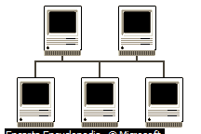
BUS topology:
Have one long cable, known as the BACKBONE with everything else attached along it.
Each connection point is called a NODE.
Every computer along the line receives each signal sent.
If there is a lot of traffic or a large number of computers, the communication can be slow.

Slide 11
Advantages Of Bus/Line Topology:
It is cheap since it does not use much cabling.
If there is a break between the backbone and a computer then only that computer is affected.

Slide 12
Disadvantages Of Bus/Line Topology:
If there is a break in the backbone then the whole network will stop working.
If there is a lot of traffic or a large number of computers, the communication can be slow.

Slide 13
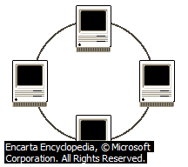
RING topology:
The computers are linked together by cables in a circle.
The data only flows in one way around the network.
it is suitable for a small number of computers (15).

Slide 14
Advantages Of Ring Topology:
It is relatively cheap and fast.
No file server needed.

Slide 15
Disadvantages Of Ring Topology:
If one computer breaks down the network stops working
Can become slow if there is a lot of traffic
It is difficult to add or remove computers

Slide 16
STAR topology:
Each computer has its own separate connection to the file-server
Faster than a bus network

Slide 17
Advantages Of Star Topology:
If one cable fails, it does not affect the other computers, meaning the network is more fault tolerant.
The layout makes it easy to add or remove individual computers.

Slide 18
Disadvantages Of Star Topology:
Are more expensive because more cabling is required

Slide 19
Transmission Media
The material which forms the connection between the computers or devices in a network. E.g. air (in the case of wireless), metal wire, optical fiber.
This can be wired or wireless.
Wires add considerably to the cost of a network, especially the cost of installing them.
The main forms of data transfer are:
Metal wires
Fiber optic cables
Wireless

Slide 20
Metal wires
Offer a high transmission speed
Expensive to buy and install
Can suffer from interference / data corruption
There are three different types:
Unshielded twisted pair: (telephone line)
Shielded twisted pair (cable tv)

Slide 21
Unshielded and Shielded TP
Unshielded Twisted Pair (UTP)
Ordinary telephone wire
Cheapest
thin wires are twisted to help cancel out interference but it still suffers from external EM interference,
Thin wires mean easier installation,
Only suitable for small networks.
Shielded Twisted Pair (STP)
Metal braid or sheathing that reduces interference which protects the data signals from outside interference/corruption,
More expensive than unshielded twisted pair
Harder to handle (thick, heavy)
Greater transmission speeds than unshielded twisted pair

Slide 22
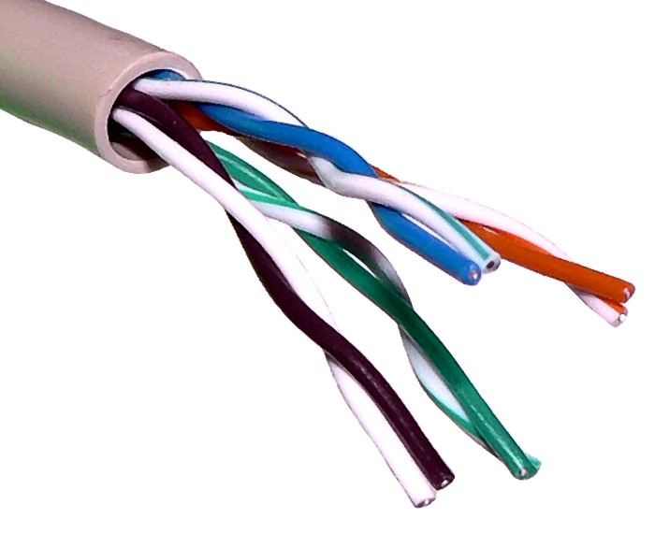
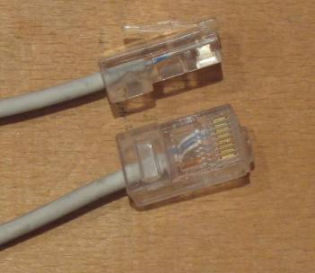
uTP – unShielded twisted pair
Unshielded Twisted Pair cable is currently the most popular method of implementing an Ethernet LAN (Local area network). It is far easier to manipulate than coaxial cable

Slide 23
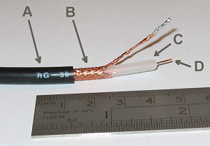
STP – Shielded twisted pair

Slide 24
FIBER OPTIC CABLES
The data being passed is encoded as pulses of light through a very thin glass fiber.
Bundles of fibers are used to carry the data to and from the network.
Speed- the data travels much faster,
Small size – a hug amount of data can travel in a very small cable,
Lack of electrical interference
Cost – the devices needed to connect the cables and the cable itself are more expensive
Can be bent around corners

Slide 25
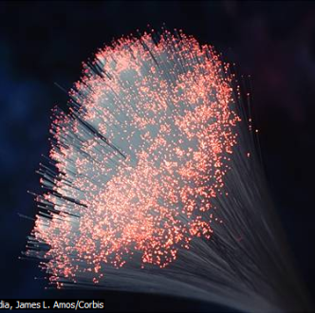
Fiber optic cables

Slide 26
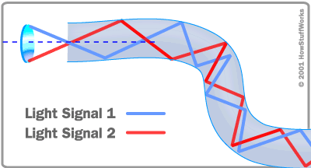
Inside Fiber optic cables

Slide 27
WIRELESS
The data transfer medium is the air
Uses radio waves
Allows you to connect anywhere there is a radio signal.

