Slide 1
DATA INTEGRITY AND SECURITY
By Mrs. Smith

Slide 2
Data Integrity
Accurate
Complete
Valid

Slide 3
Data Integrity
Data integrity refers to the validity of data.
Making sure data stored is accurate.
Ensuring data stored is not intentionally altered.

Slide 4
How can data integrity be compromised?
Inaccurate data entry
Viruses
Hardware malfunctions
Accidental or Malicious deletion or changing of data
Natural Disasters

Slide 5
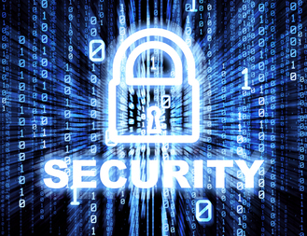
Data Security
Data security is ensuring your data is not compromised.
Data security can be classified into two main groups:
Physical safeguards
Software safeguards

Slide 6
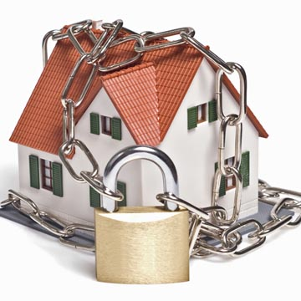
Physical Safeguards

Slide 7
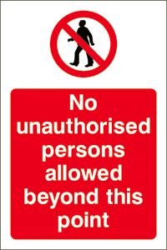
Only allow authorized personnel access to computer facilities.

Slide 8
Hire Security Guards

Slide 9
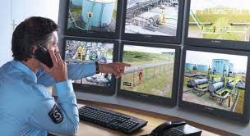
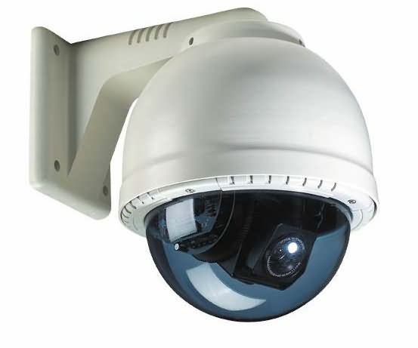
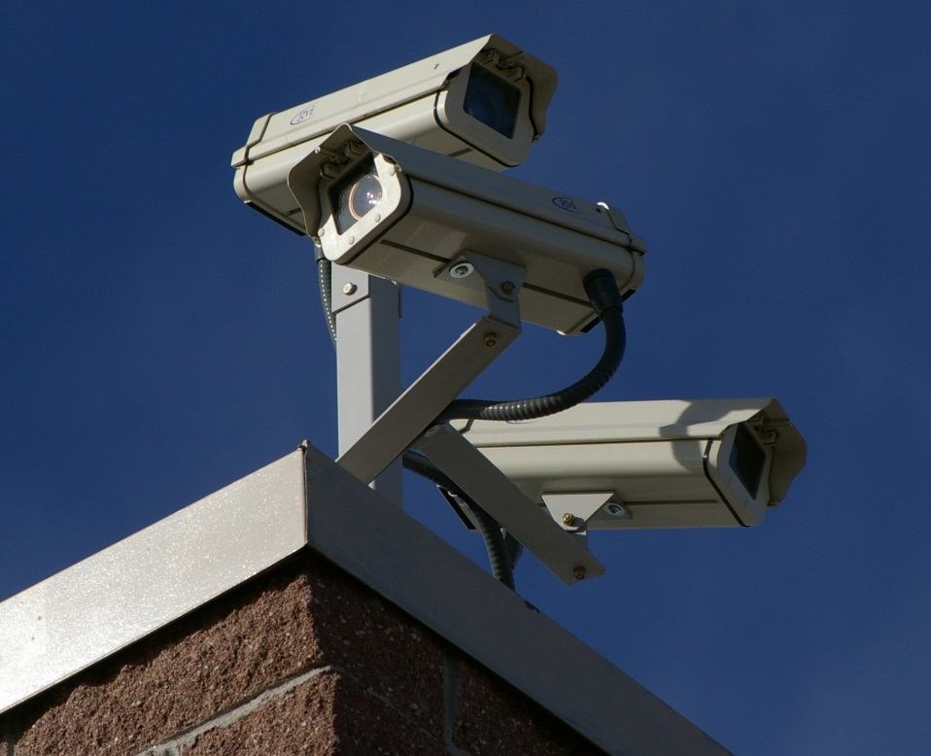
Install monitoring systems using video cameras

Slide 10
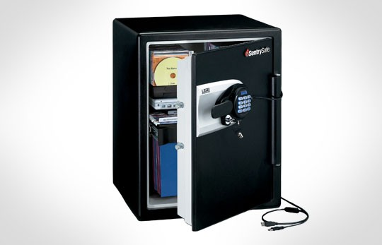
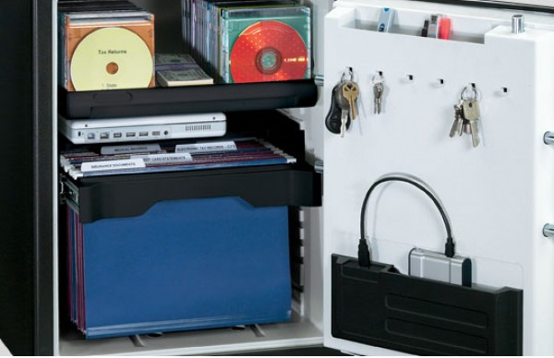
Storing backed up data in a fireproof safe

Slide 11
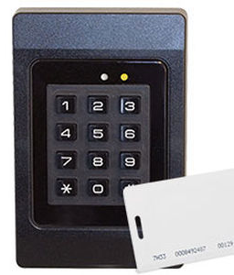
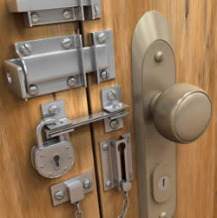
Installing locks on doors

Slide 12
Software Safeguards

Slide 13
#1 Using Passwords to access the Computer System

Slide 14
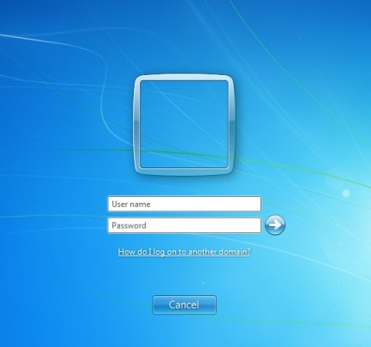

Slide 15
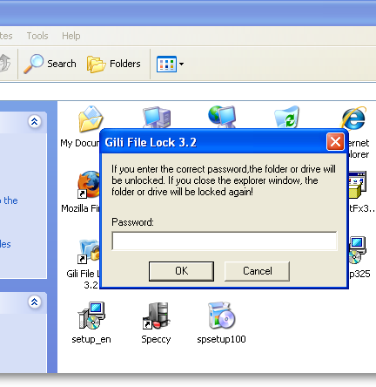
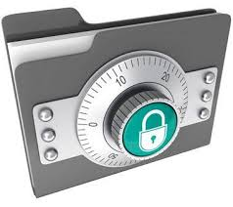
#2 Using passwords for individual files or folders.

Slide 16
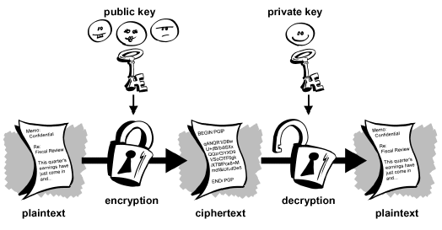
#3
Data Encryption –
Coding/ Scrambling your data
the encoded version of a message

Slide 17
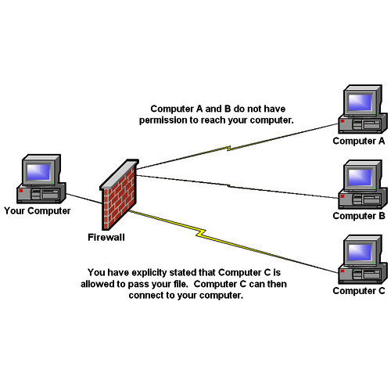
#4 Installing a Firewall (filters the information coming to your computer from the Internet)

Slide 18
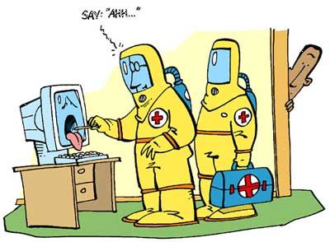
Viruses

Slide 19
What is a virus?
A malicious program that activates itself unknown to the user and destroys or corrupts data.

Slide 20
How are they usually spread?
Downloading infected programs and files from t he internet
Opening infected files received through emails
Using storage devices that contain infected files

Slide 21
Effects of viruses
A business can lose millions of dollars due to:
data corruption,
Lost data and
computer down time

Slide 22
Prevention and protection against viruses
Install antivirus software and always keep it up to date with the latest virus definitions
Do not use storage devices from other computers in your computer unless you scan for viruses first
Do not open email attachments that contain .exe, .com or .vbs file extensions

Slide 23
Data privacy
The right of individuals to determine what information is being kept about them and how the information will be used.
Data privacy act 1984 – requires that all data being kept about an individual be accurate and used only for the purpose for which it was collected

Slide 24
Data Privacy Act 1984 USA
It requires that all data being kept about an individual be accurate and used only for the purpose for which it was collected

Slide 25
Data Protection Act 1998 UK
Ensures that any organization, company or governmental organization storing information on individuals abides by the following rules:
Data must not be used for any purpose other than what it was collected for
Data must be updated to maintain integrity
Data must be protected from unauthorized access and use
Individuals have the right to check data held about them

Slide 26
Freedom of Information Act 1999 TT
This act ensures:
Transparency
Accountability
Equality of Access
Empowerment and Increased Participation

Slide 27
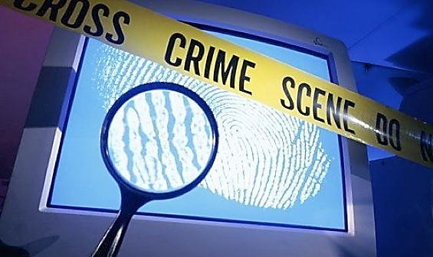
COMPUTER CRIMES
Software piracy
Hacking
Internet Fraud

Slide 29
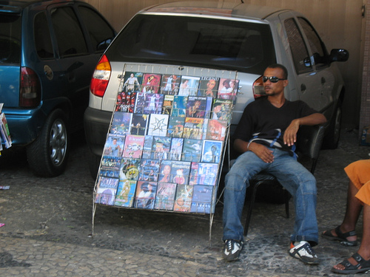

Slide 30
Software Piracy
The unauthorized copying, use or selling of software that is copyrighted

Slide 31
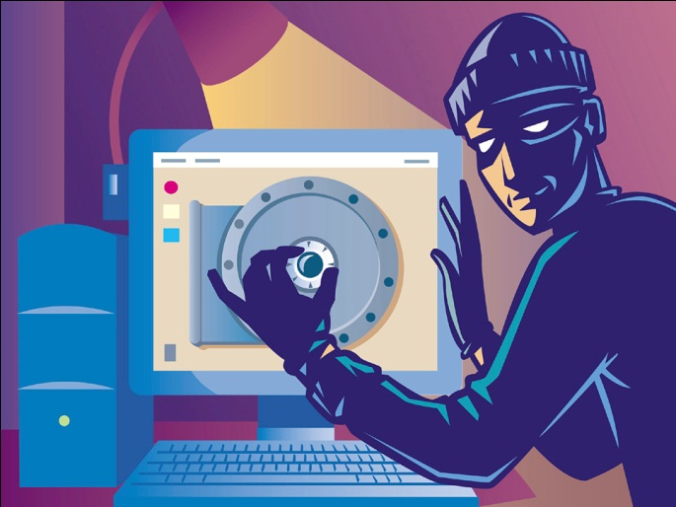
Hacking
The unauthorized accessing of a computer system:
To steal confidential data
To copy computer programs illegally
To alter data
To destroy data (deleting or implanting virus)
To transfer money using Electronic Funds Transfer (EFT)

Slide 32
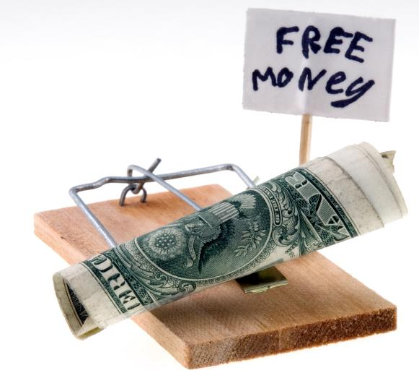

Slide 33
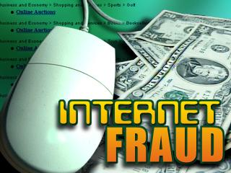
Mainly the bogus selling of products over the internet

Slide 34
For a copy of this powerpoint and further reading: www.yolasite.chss.com

