Slide 1
U1M2#7 Purpose And Function Of Network Components
TYPES OF NETWORKS
PROTOCOLS
NETWORK CONFIGURATIONS /TOPOLOGIES
TRANSMISSION MEDIA
By B. Vialva

Slide 2
TYPES OF NETWORKS
Networks can be classified according to the geographical area they occupy.
LAN – Local Area Network
MAN - Metropolitan Area Network
WAN – Wide Area Network

Slide 3
Classification of interconnected processors by scale.

Slide 4
Main features of LANs are:
Confined to a single building or site – the hardware and communications equipment is contained in one building or site.
Ownership of the communications equipment – the organization actually owns all the communications equipment (such as wiring, etc.) that links the terminals.

Slide 5
Main features of MANs
A metropolitan area network (MAN) covers a city or a region of a city.
MANs have very high transfer speeds
MANs support
high-speed disaster recovery systems
real-time transaction backup systems
interconnections between corporate data centers and internet service providers, and government, business, medicine, and education high-speed interconnections.
Almost exclusively fiber optic systems
The biggest advantage is communication with other people and the biggest disadvantage would be security.
MANs are very often a ring topology

Slide 6
A PHYSICAL RING USED TO SUPPORT A METROPLITAN AREA NETWORK

Slide 7
Main features of WANs are:
Hardware is spread over a wide geographical area – devices (computers, point of sale terminals, storage, etc.). The devices spread over multiple buildings and sites.
Third party telecommunications equipment is used – hardware in a WAN is situated in many sites, which can be in different countries. Telephone radio and satellite communications are needed, which are supplied by a third party. The organization with the WAN has to rent these services from a telecommunications supplier.

Slide 8
Internet
Internet – a huge group of networks joined together. Each of these networks consists of lots of smaller networks.

Slide 9
Difference between the www and the internet
The internet and the WWW is not the same thing.
World Wide Web – is a means of accessing information contained on the internet. It is an information sharing model that is built on top of the internet.
The www uses HTTP(hypertext transfer protocol), which is one of the languages used over the internet to transmit information.
The www makes use of browser software used to access documents called web pages.

Slide 10
These types of networks use internet technology:
INTRANET
EXTRANET

Slide 11
INTRANET:
It is a private internal network which allows employees of an organization to access and share information and resources.
It uses the same technology as that used by the internet for sending of messages across the network.
The concepts of client and server are used for the computers in an intranet along with the same protocols (HTTP, FTP and e-mail) as used by the internet.
The main feature of the intranet is that only employees of the organization are able to use it.
NOTE: it is still possible for people on an intranet to access the internet; they are not confined to the intranet site.

Slide 12
EXTRANET:
These are intranets opened to selected groups of users outside the company such as customers, suppliers, as well as employees of the organization.
It is not accessible to the general public and this is ensured by the use of usernames and passwords.
Because the people who need access to the information are not on the same site, data needs to be sent using third party telecommunication lines.
Data can be sent via the internet or it can be sent using the more expensive private communication lines which offer more security and performance.

Slide 13
EXTRANET cont’d:
If the internet is used for the sending of the data in an extranet, the following security measures have to be put in place:
Gateways – is used to link together different types of networks.
Firewalls- hardware and/or software that work in a network to prevent communication that is not allowed from one network to another.
Encryption – coding data whilst it is being sent over a network so that only the true recipient is able to decode it. Should the data be intercepted by a hacker, then the data will be in a code that is totally meaningless.
User authentication – having to supply a valid username with matching password.

Slide 14
PROTOCOLS
A set of standards or rules that allows the transmission of data between computers (or different devices) on a network.
When I.T. devices are linked together they must be able to communicate.
Even though the hardware or the software is not the same, the communications link between them have to be compatible, therefore modern computer networks set PROTOCOLS (rules) so that data sent from one computer can be understood by another computer.

Slide 15
PROTOCOLS
Different types of protocols:
IP – Internet Protocol
TCP – Transmission Control Protocol
FTP – File Transfer Protocol
HTTP – Hypertext Transfer Protocol

Slide 16
Network configurations
Networks can be arranged in various ways depending on the number of computers and how they are going to be used.
The way the network is arranged is called the TOPOLOGY.
Bus/line
Star
Ring

Slide 17
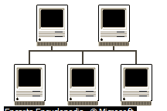
BUS topology:
Have one long cable, known as the BACKBONE with everything else attached along it.
Each connection point is called a NODE.
Every computer along the line receives each signal sent.
If there is a lot of traffic or a large number of computers, the communication can be slow.

Slide 18
Advantages Of Bus/Line Topology:
It is cheap since it does not use much cabling.
If there is a break between the backbone and a computer then only that computer is affected.

Slide 19
Disadvantages Of Bus/Line Topology:
If there is a break in the backbone then the whole network will stop working.
If there is a lot of traffic or a large number of computers, the communication can be slow.

Slide 20
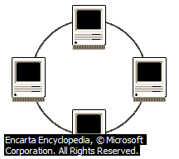
RING topology:
The computers are linked together by cables in a circle.
The data only flows in one way around the network.
it is suitable for a small number of computers (15).

Slide 21
Advantages Of Ring Topology:
It is relatively cheap and fast.
No file server needed.

Slide 22
Disadvantages Of Ring Topology:
If one computer breaks down the network stops working
Can become slow if there is a lot of traffic
It is difficult to add or remove computers

Slide 23
STAR topology:
Each computer has its own separate connection to the file-server
Faster than a bus network

Slide 24
Advantages Of Star Topology:
If one cable fails, it does not affect the other computers, meaning the network is more fault tolerant.
The layout makes it easy to add or remove individual computers.

Slide 25
Disadvantages Of Star Topology:
Are more expensive because more cabling is required

Slide 26
Transmission Media
The material which forms the connection between the computers or devices in a network. E.g. air (in the case of wireless), metal wire, optical fiber.
This can be wired or wireless.
Wires add considerably to the cost of a network, especially the cost of installing them.
The main forms of data transfer are:
Metal wires
Fiber optic cables
Wireless

Slide 27
Metal wires
Offer a high transmission speed
Expensive to buy and install
Can suffer from interference / data corruption
There are three different types:
Unshielded twisted pair: (telephone line)
Shielded twisted pair (cable tv)

Slide 28
Unshielded and Shielded TP
Unshielded Twisted Pair (UTP)
Ordinary telephone wire
Cheapest
thin wires are twisted to help cancel out interference but it still suffers from external EM interference,
Thin wires mean easier installation,
Only suitable for small networks.
Shielded Twisted Pair (STP)
Metal braid or sheathing that reduces interference which protects the data signals from outside interference/corruption,
More expensive than unshielded twisted pair
Harder to handle (thick, heavy)
Greater transmission speeds than unshielded twisted pair

Slide 29
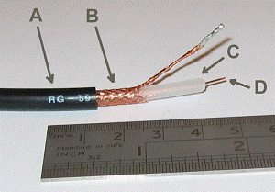
STP – Shielded twisted pair

Slide 30
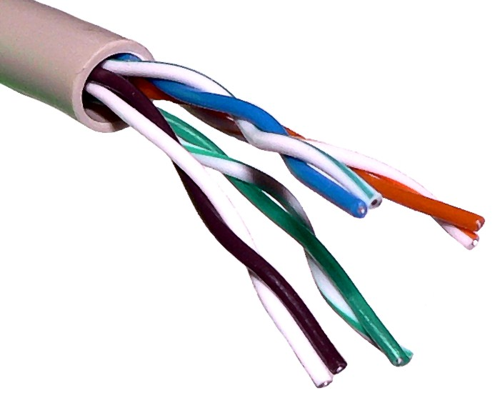
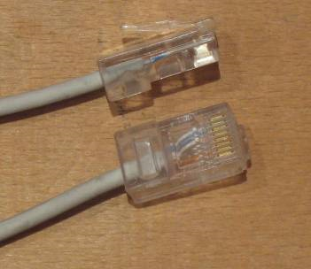
uTP – unShielded twisted pair
Unshielded Twisted Pair cable is currently the most popular method of implementing an Ethernet LAN (Local area network). It is far easier to manipulate than coaxial cable

Slide 31
FIBER OPTIC CABLES
The data being passed is encoded as pulses of light through a very thin glass fiber.
Bundles of fibers are used to carry the data to and from the network.
Speed- the data travels much faster,
Small size – a hug amount of data can travel in a very small cable,
Lack of electrical interference
Cost – the devices needed to connect the cables and the cable itself are more expensive
Can be bent around corners

Slide 32
Fiber optic cables

Slide 33
Inside Fiber optic cables

Slide 34
WIRELESS
The data transfer medium is the air
Uses radio waves
Allows you to connect anywhere there is a radio signal.

Slide 35
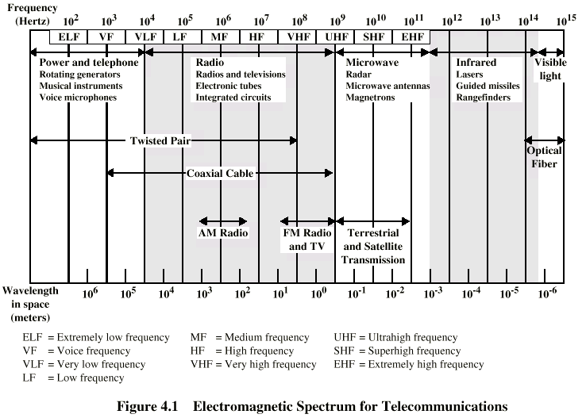
Electromagnetic Spectrum

Slide 36
Hotspot
A region where internet can be accessed wirelessly using Wi-Fi.
There are many public places where the internet can be accessed wirelessly using a person’s laptop or PDA.
Wi-Fi – a trademark for the certification of products that meet certain standards for transmitting data over wireless networks.

